Slide 1
We would like to welcome you and your child/ren to Allendale Primary School In September 2020.
Please take a look inside.

Slide 2
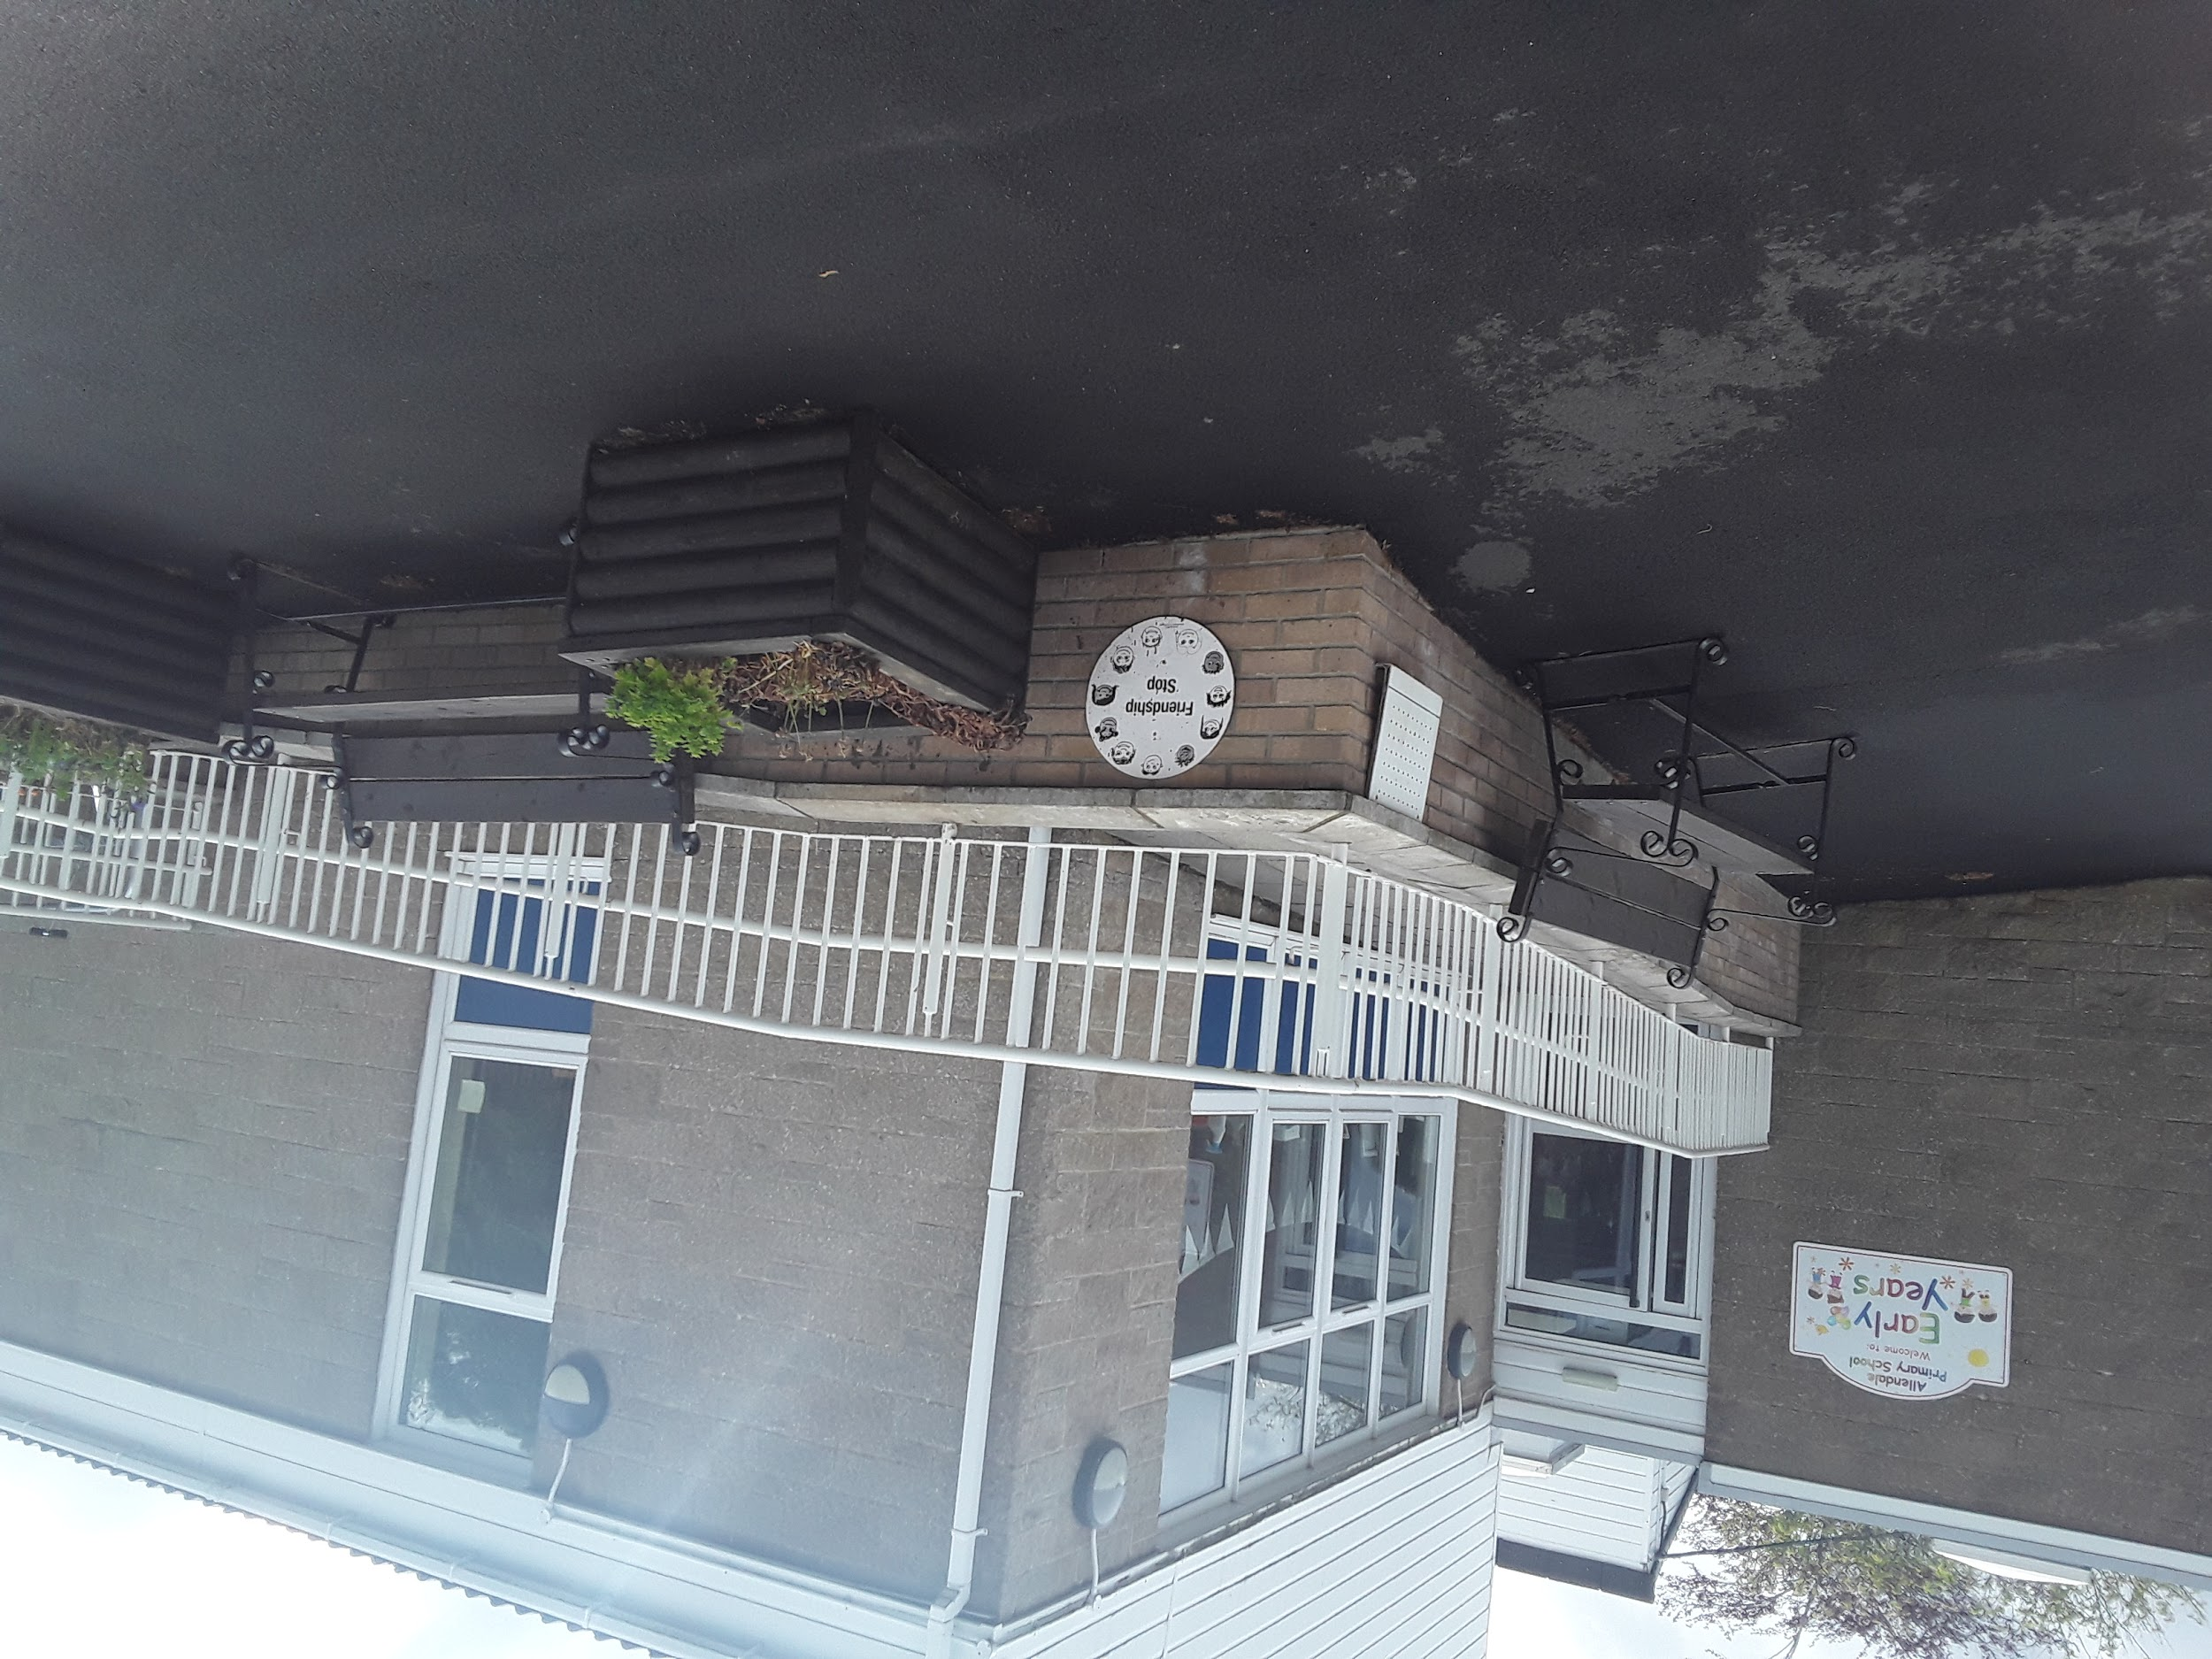
If you haven’t been to the Pipit Class at Allendale School yet, good news, you can come very soon - in September. Lots of things will be the same as they are here, but there may be a few things that are different too.

Slide 3
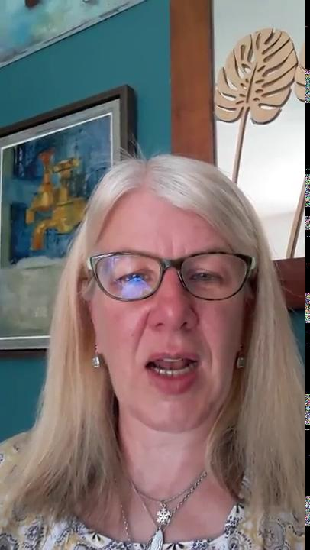
Your special grown ups/teachers are going to be Miss Armstrong and Karen. You have met us in little videos and we are looking forward to seeing you at school and going in the garden together.

Slide 4
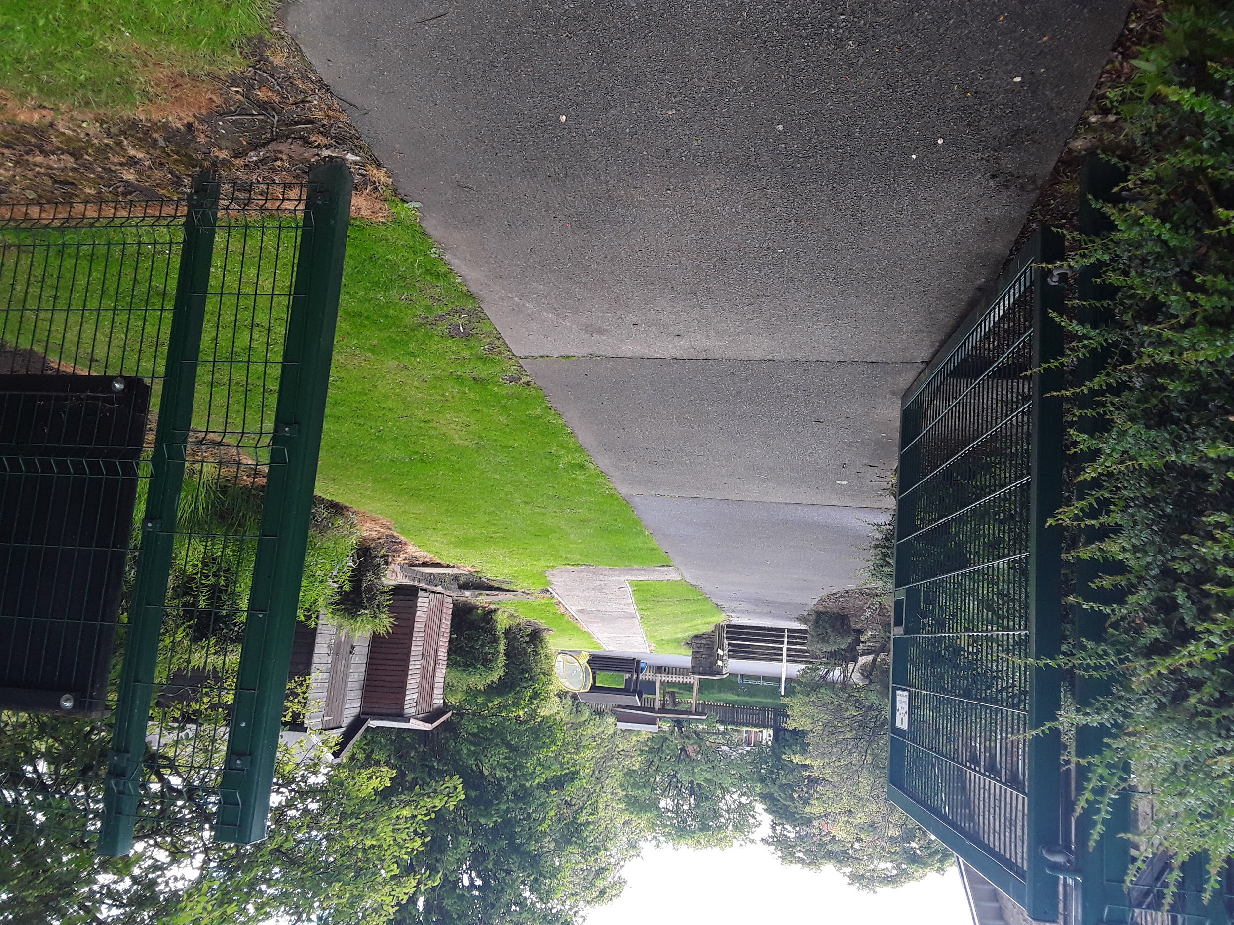
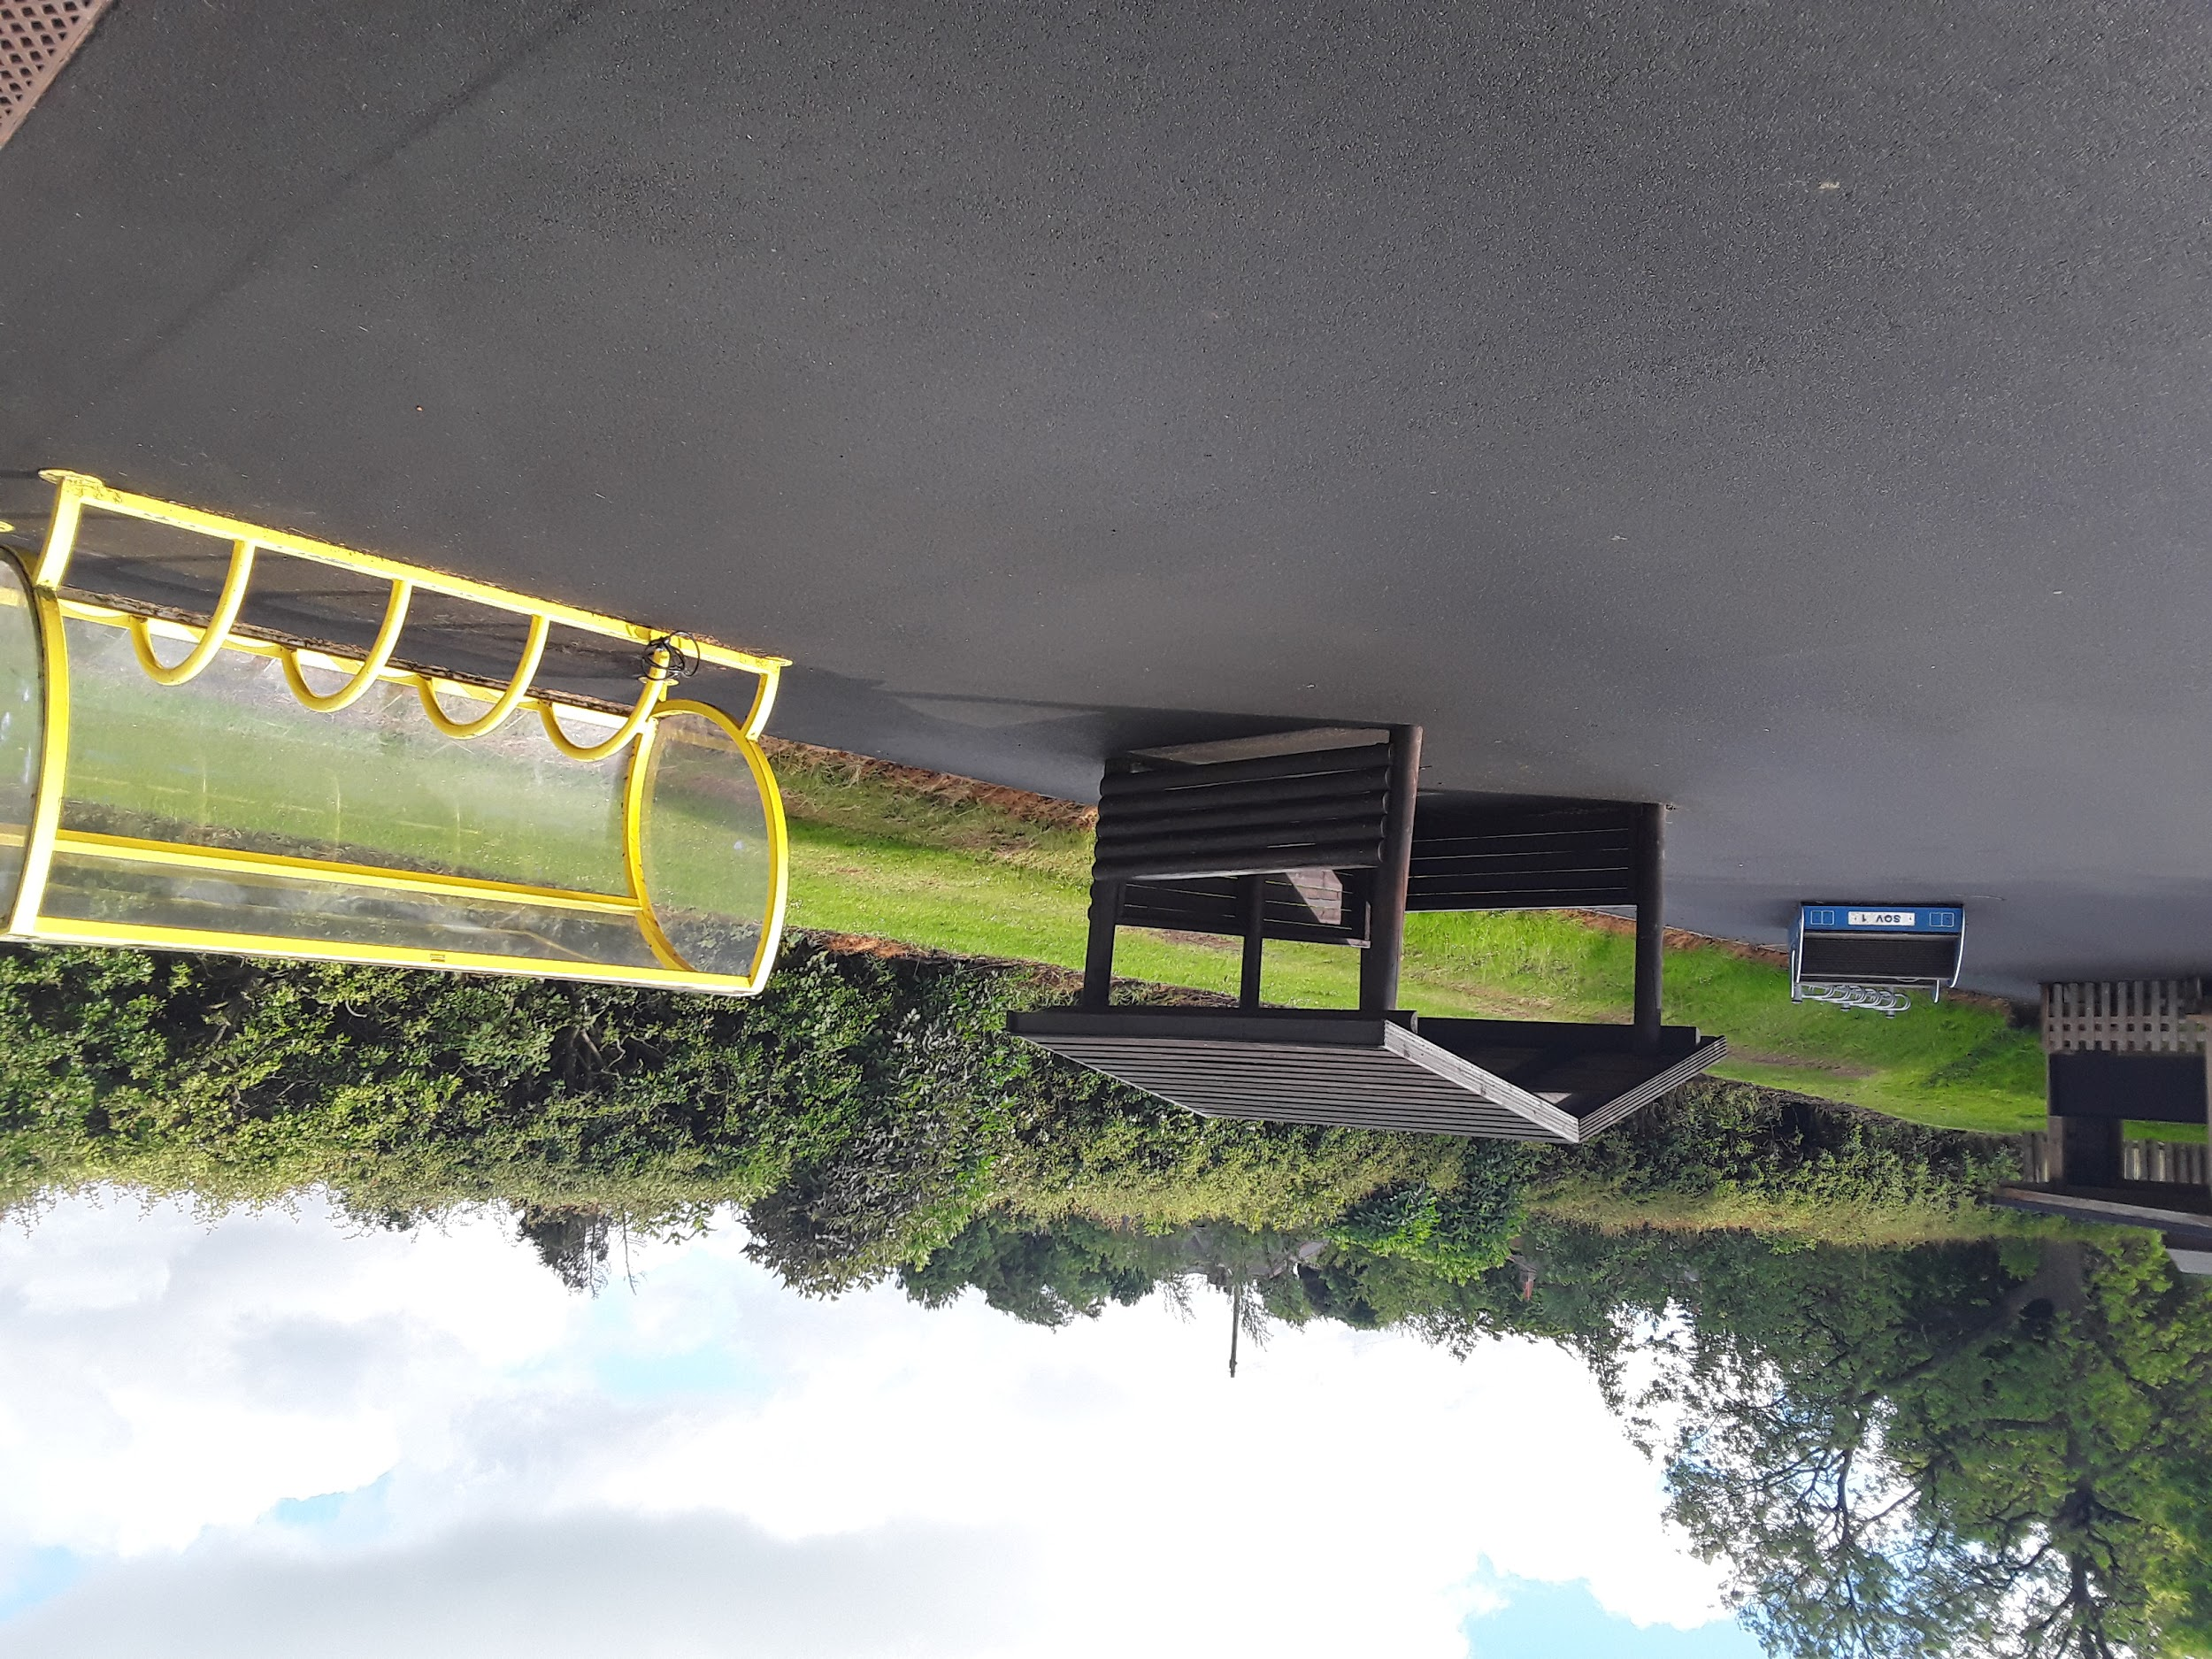
This is where your grown up will bring you when you arrive at Allendale School. We have special lines for you to wait behind to help everyone take turns coming inside and meeting Miss Armstrong and Karen.
In the morning your grown up will bring you to school and when you arrive you will wait and line up with a little 2 metre gap between you and your friends.

Slide 5
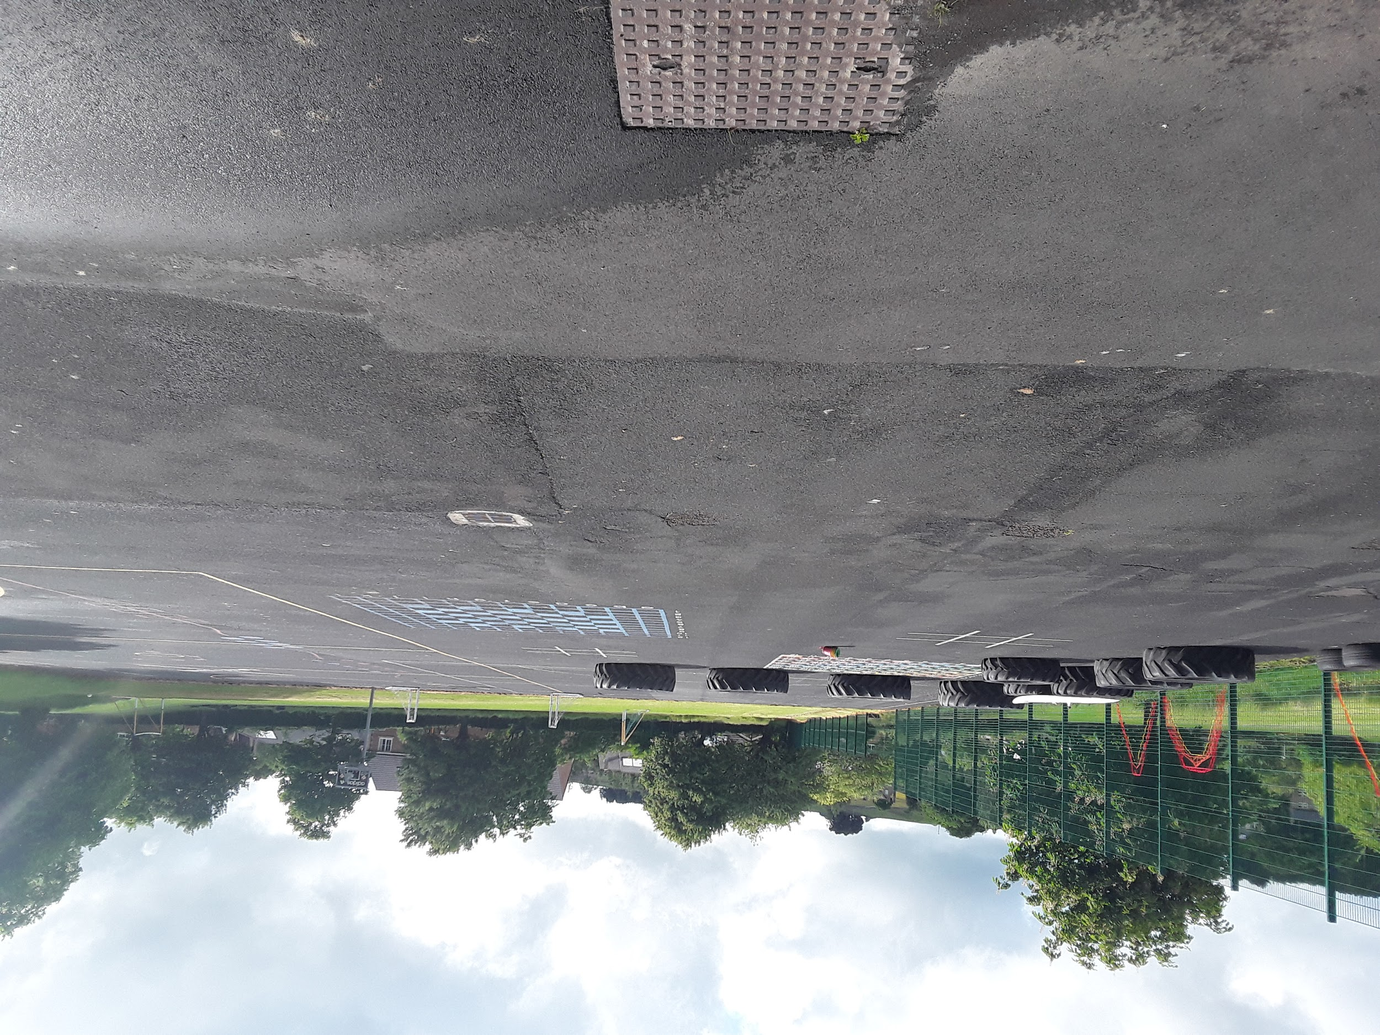
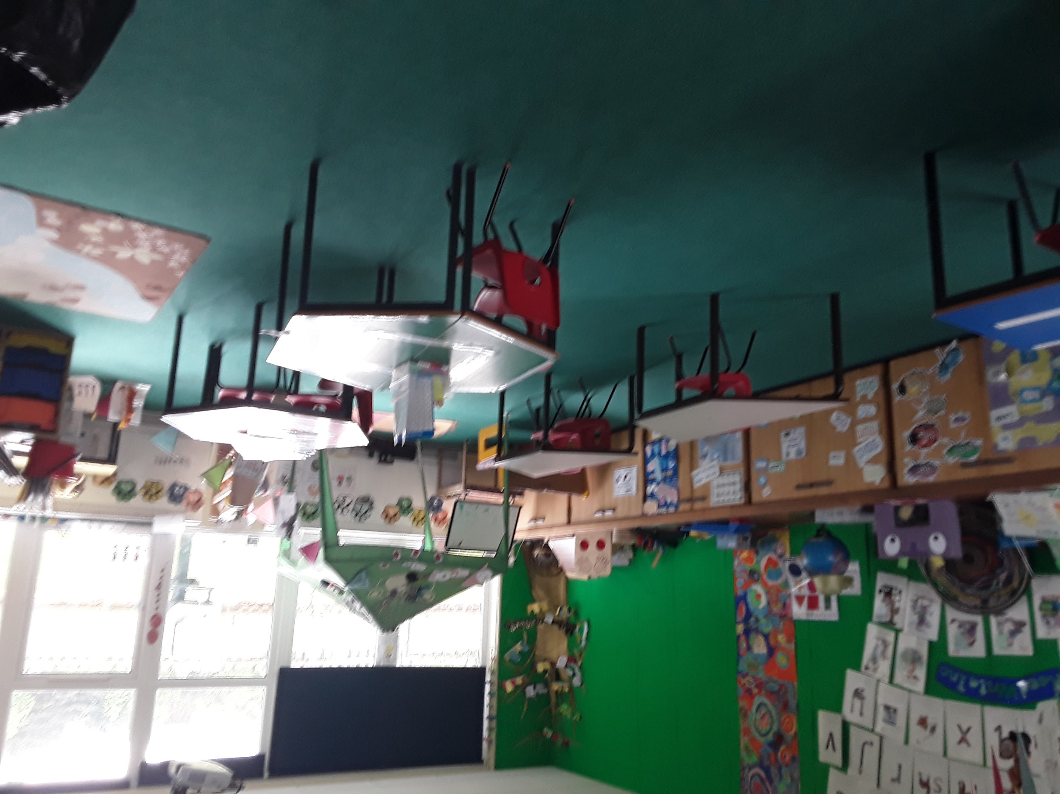
If you have been in the Pipit Class at Allendale School , good news, you can come back very soon! Lots of things will be the same as they are here, but there will be a few things that are different for a while too.

Slide 6
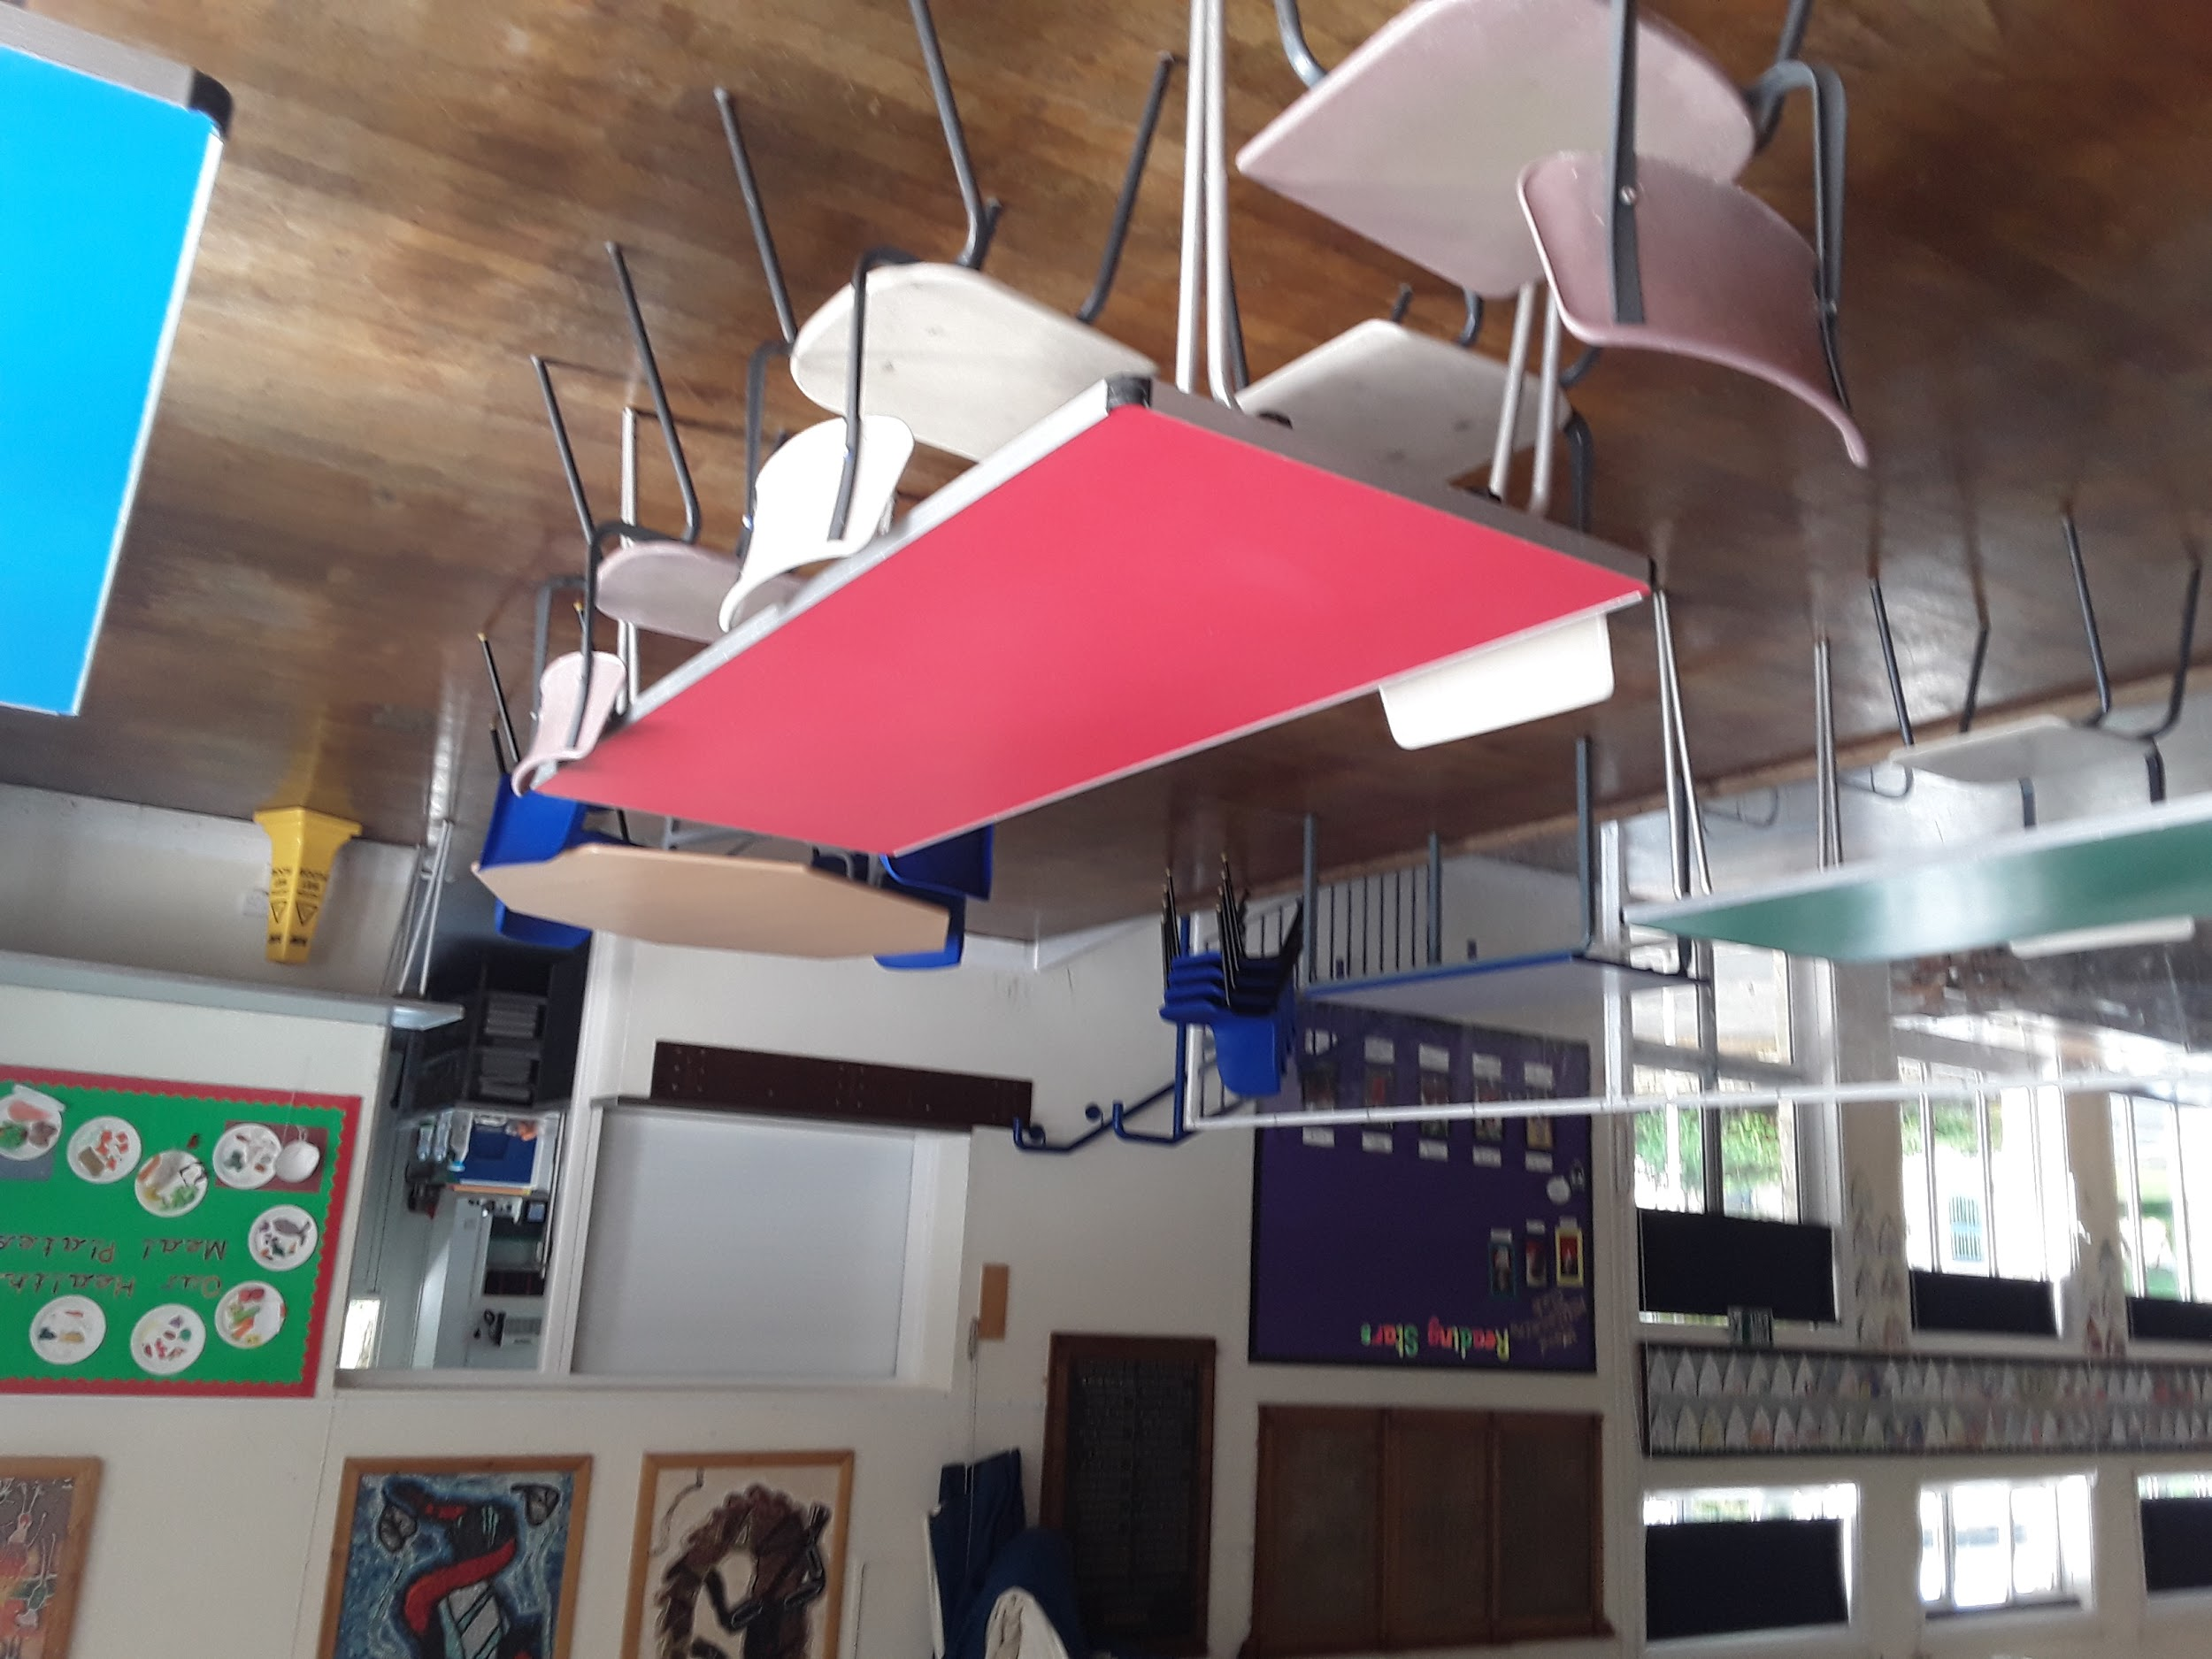
We know you might like to bring your own packed lunch or sometimes you might like to have a school dinner. This is the dinner hall where you can enjoy your lunch. We have four dinner staff to help you Mrs Nichol, Mrs Bishop, Mrs Hemmer and Miss Pringle.

Slide 7
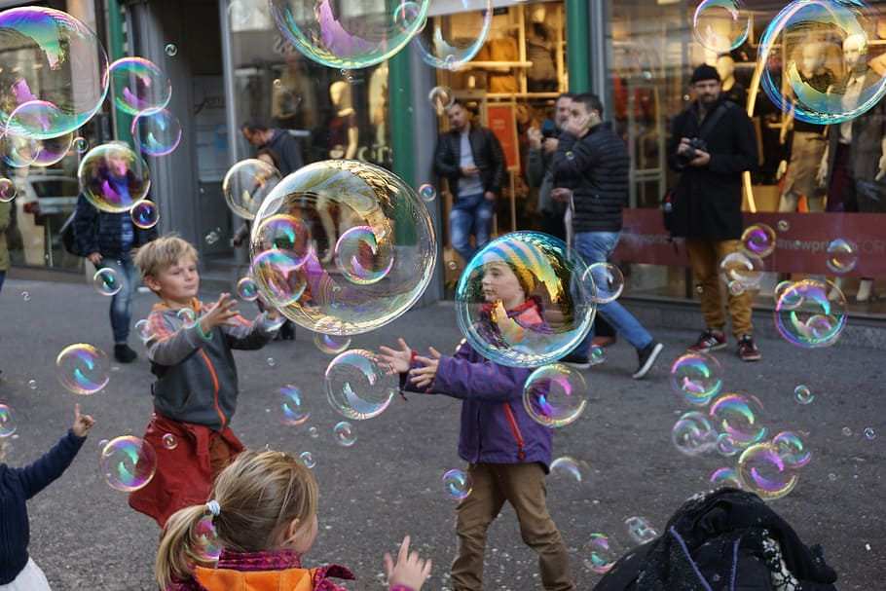
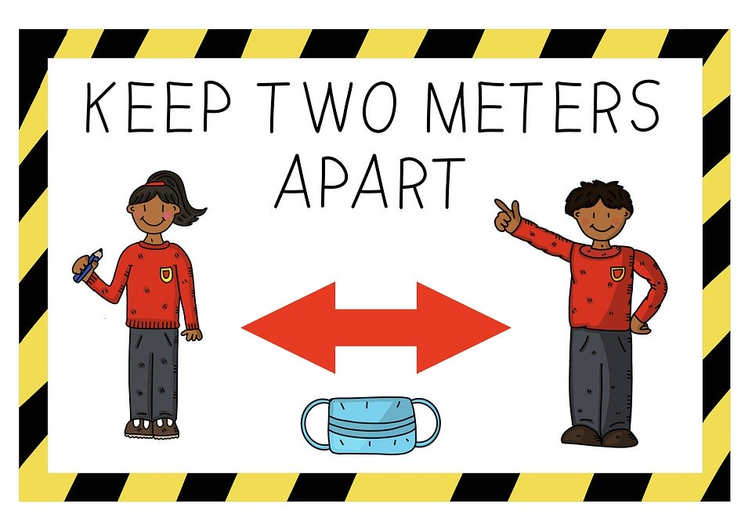
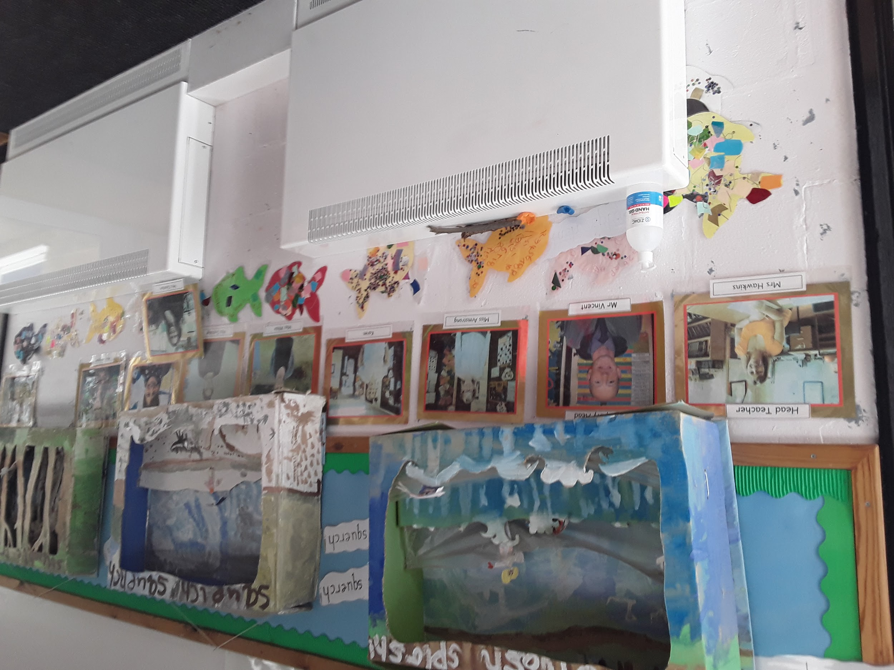
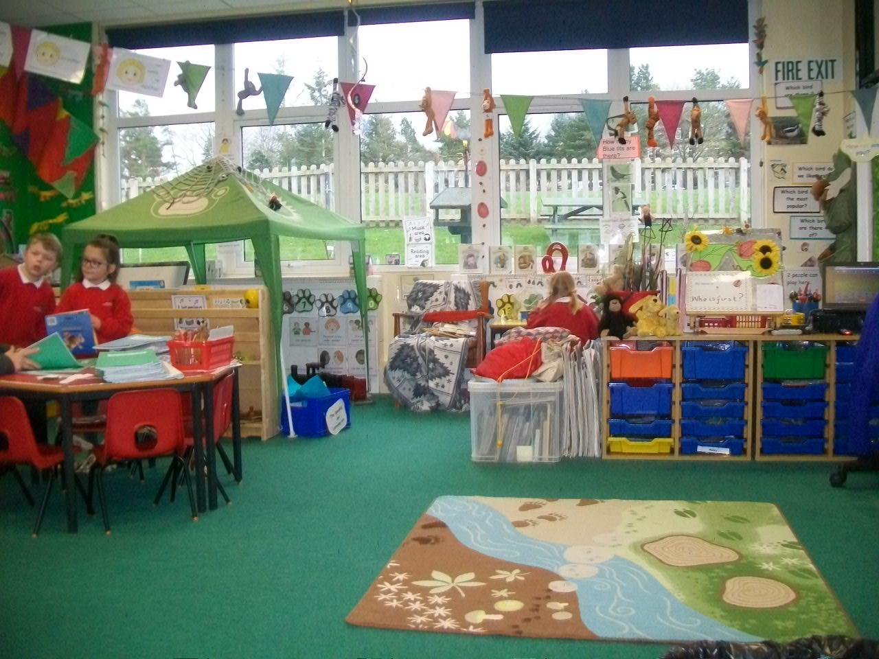
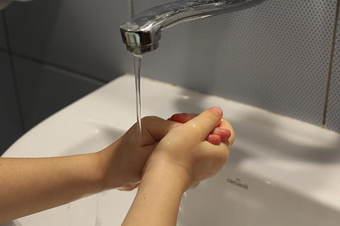
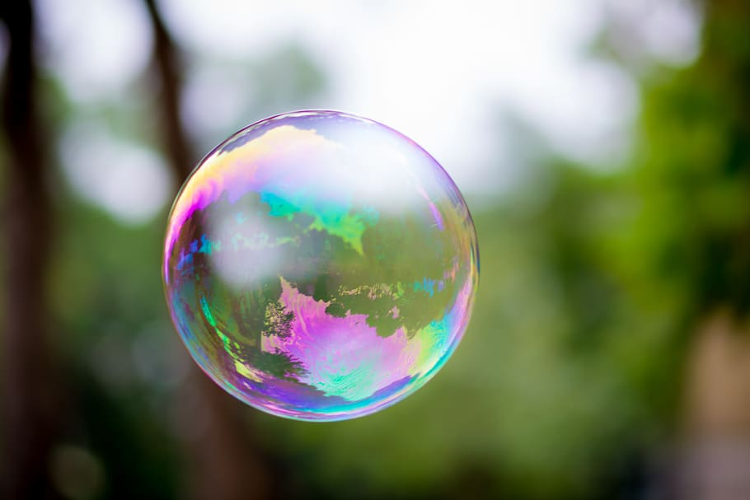
We might not all play together in one big group with the older children in the school. We will probably have to stay in our own Pipit Bubble for the time being.
So we’re going to be in a group with our Pipit Bubble friends. In our Pipit Bubble will be:
Miss Armstrong, Karen, Abigail, Agatha, Aimee, Alba, Alex, Anna, Arthur, Bobby Lee, Dylan, Evie, Florence, Harry, Holly, Lucia, Josh, Joshua, Raef, Steen and Zoe.
You might want to pretend that you are in a Little Bubble of your own that you don’t want to pop. So you have to try not to get too close to someone else. We will probably have to wait to help everyone take turns coming inside and washing our hands and so we will come straight into the toilets to do this. Then we will go into the Pipit class..

Slide 8
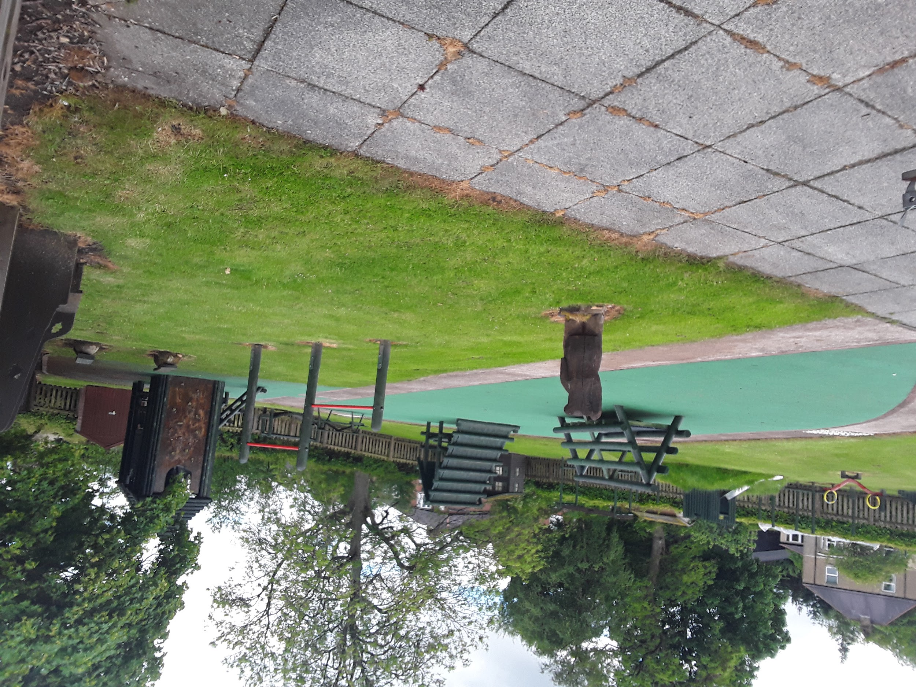
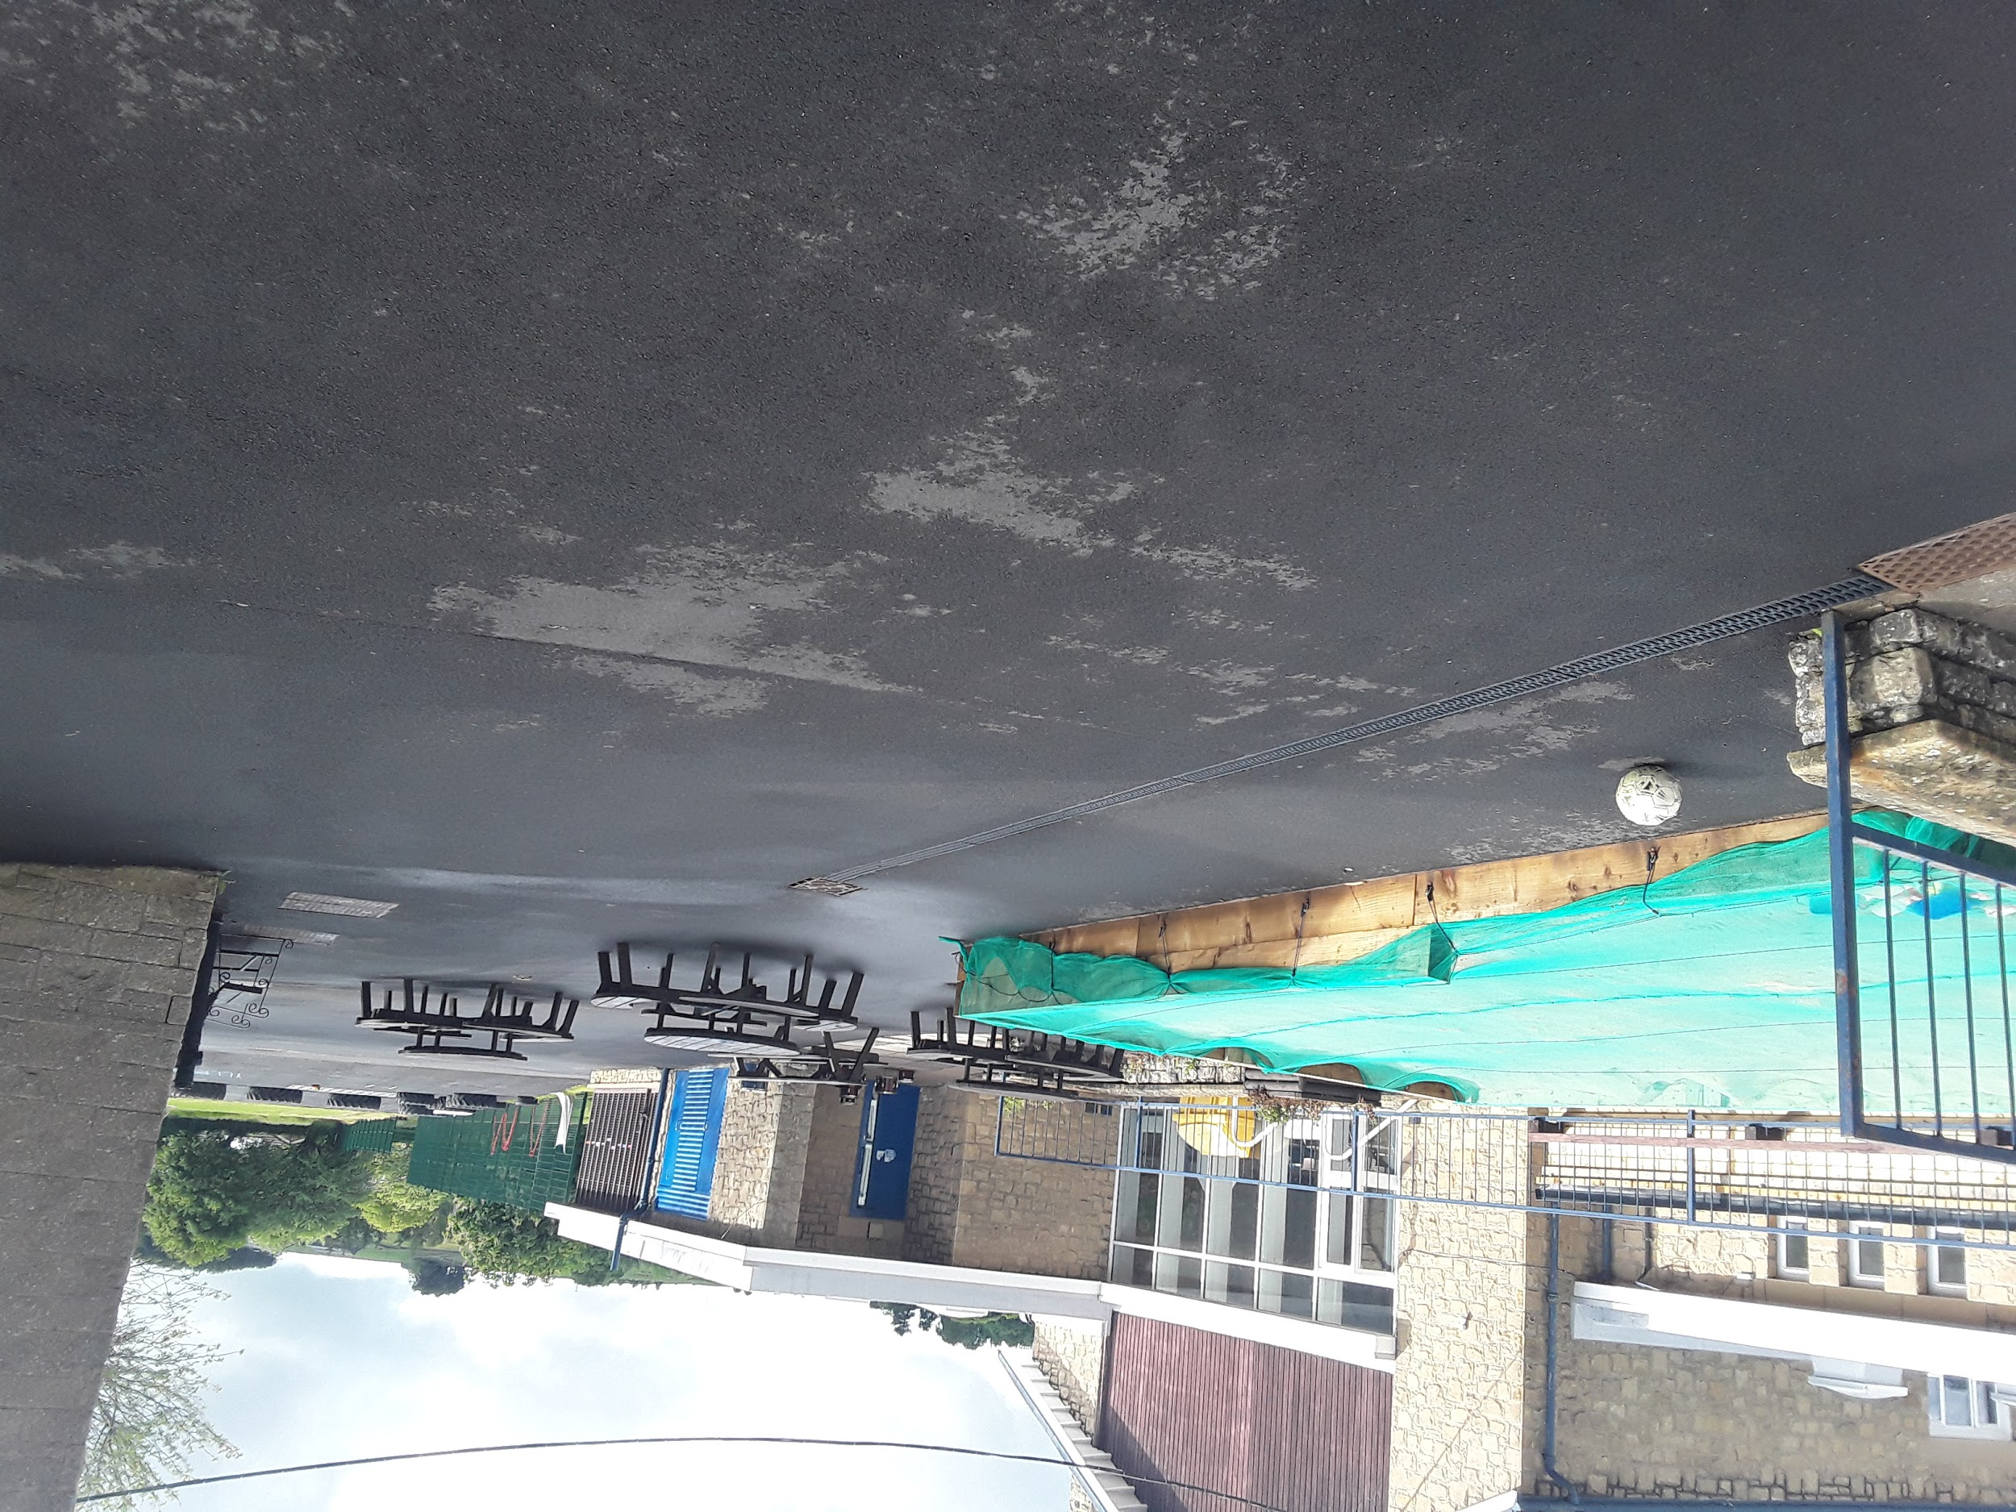
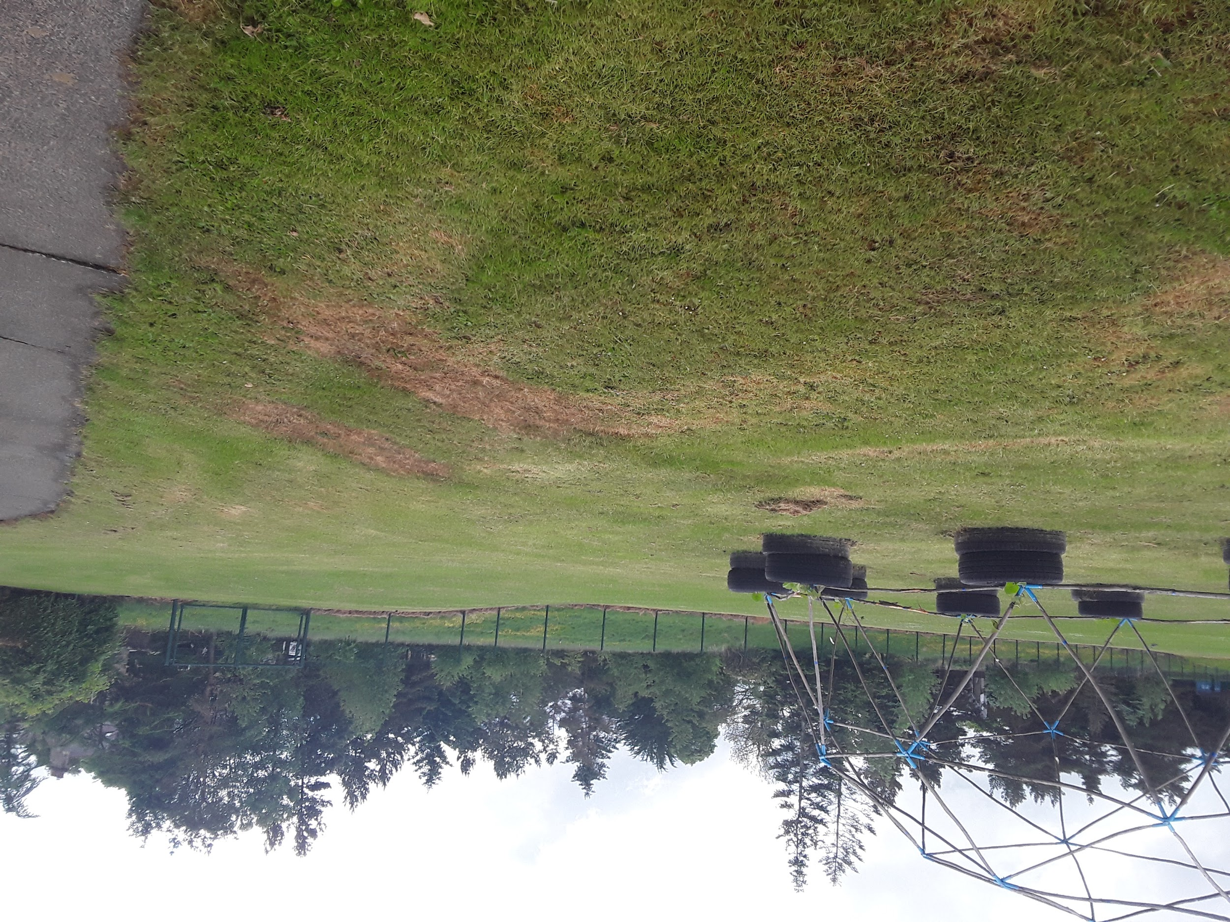
We’re probably going to be spending more time apart from the older children in the rest of the school. So we will be taking it in turns to do things like play outside, go for lunch, and wash our hands.
This is our upper garden. We can ride on vehicles, balance on the obstacle course, climb and play in the cottage.
Here are some photos of our yard, field and sand pit-we call it the Beach. You can bring wellies to keep in school and play on the field. You can also bring in your own bikes or scooters to ride on at playtimes. We can enjoy fruit most
morning playtimes together too!

Slide 9
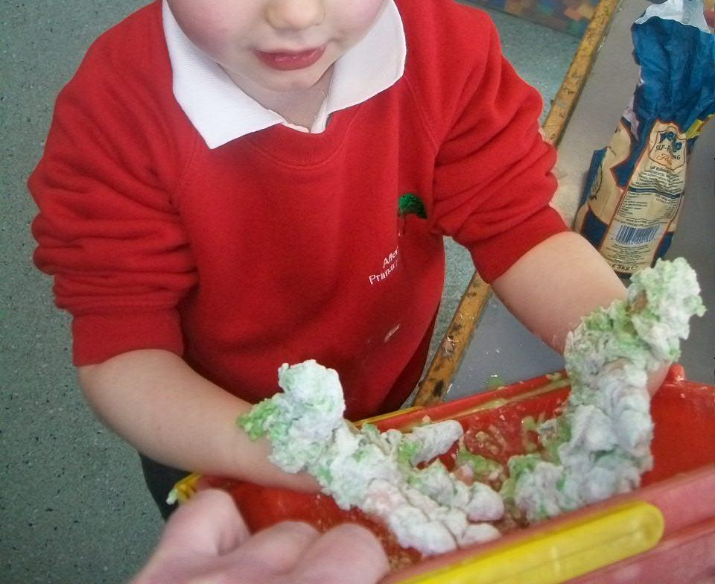
This is where we will spend lots of our time in our Pipit Bubble group. We can have milk here and listen to stories, play with our friends, sing songs and do lots of other fun activities too. You will be able to wear the red Allendale uniform jumper too when you come to school.

Slide 10
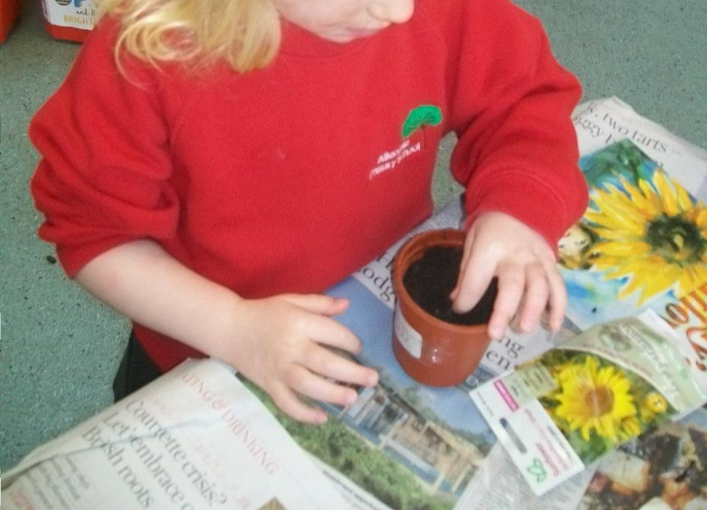
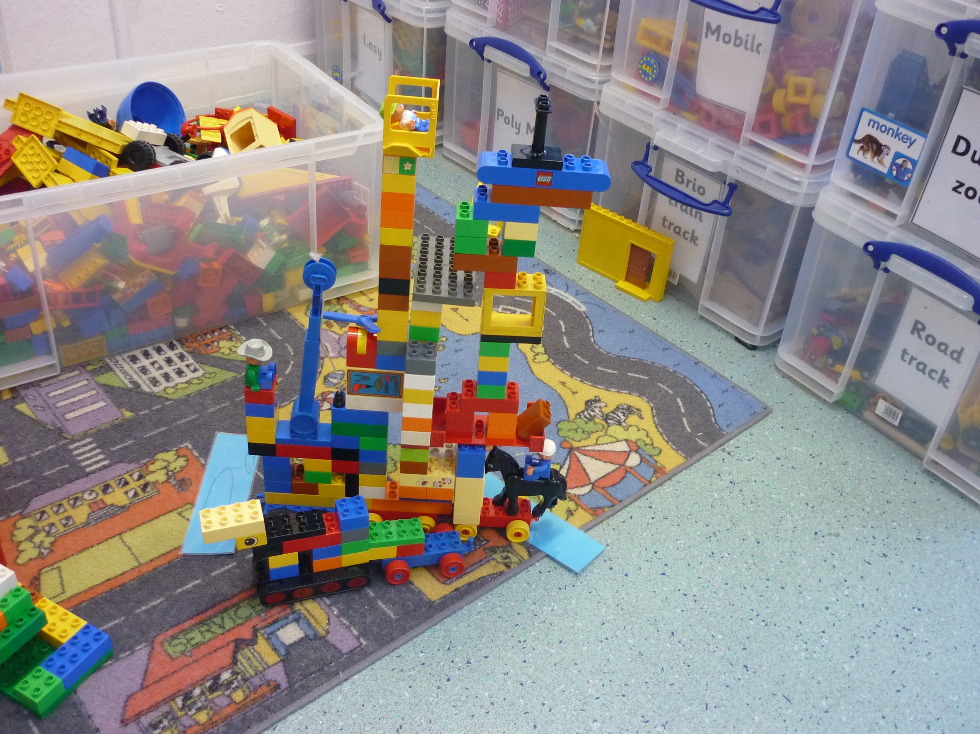
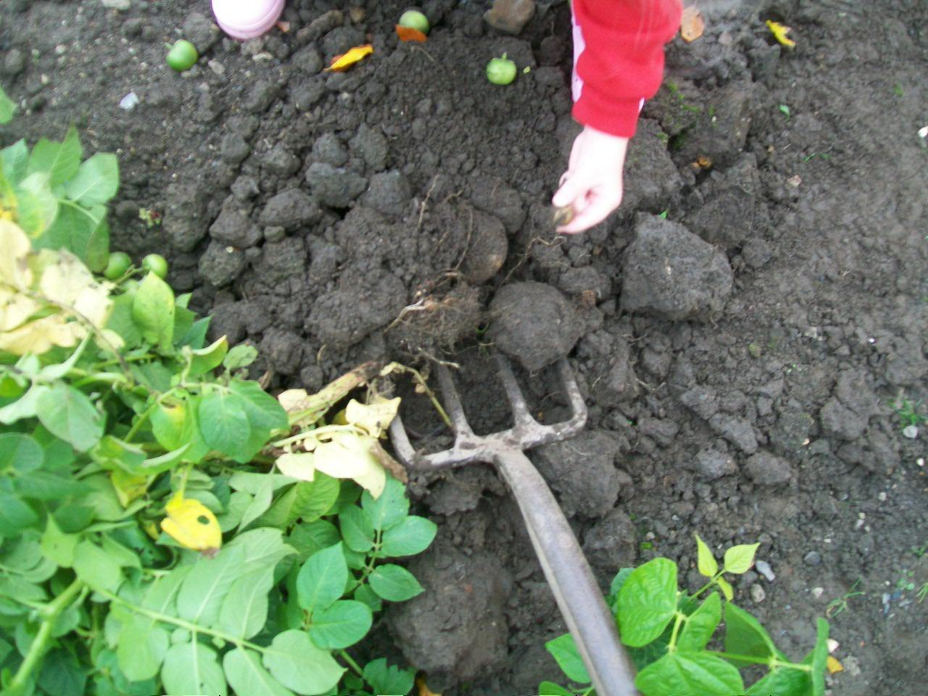
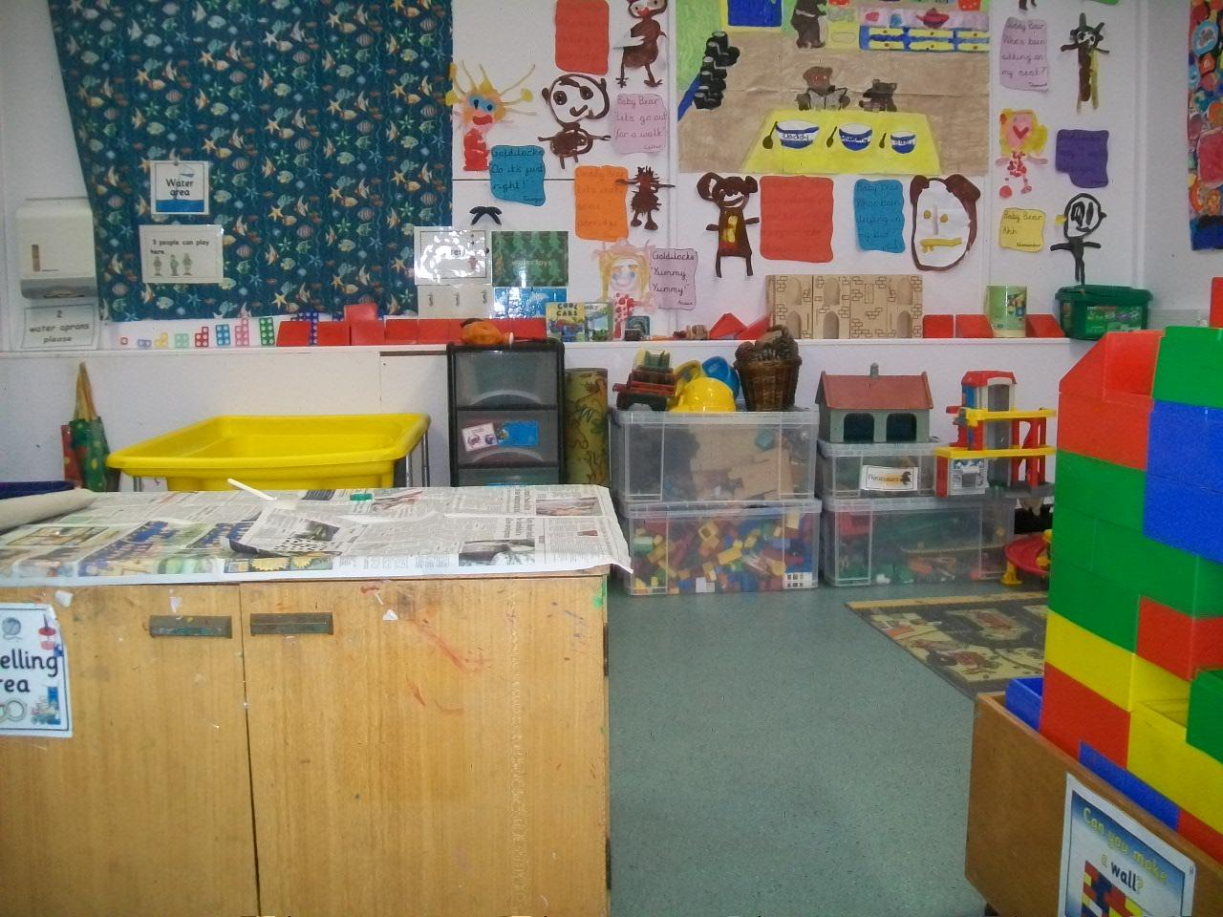
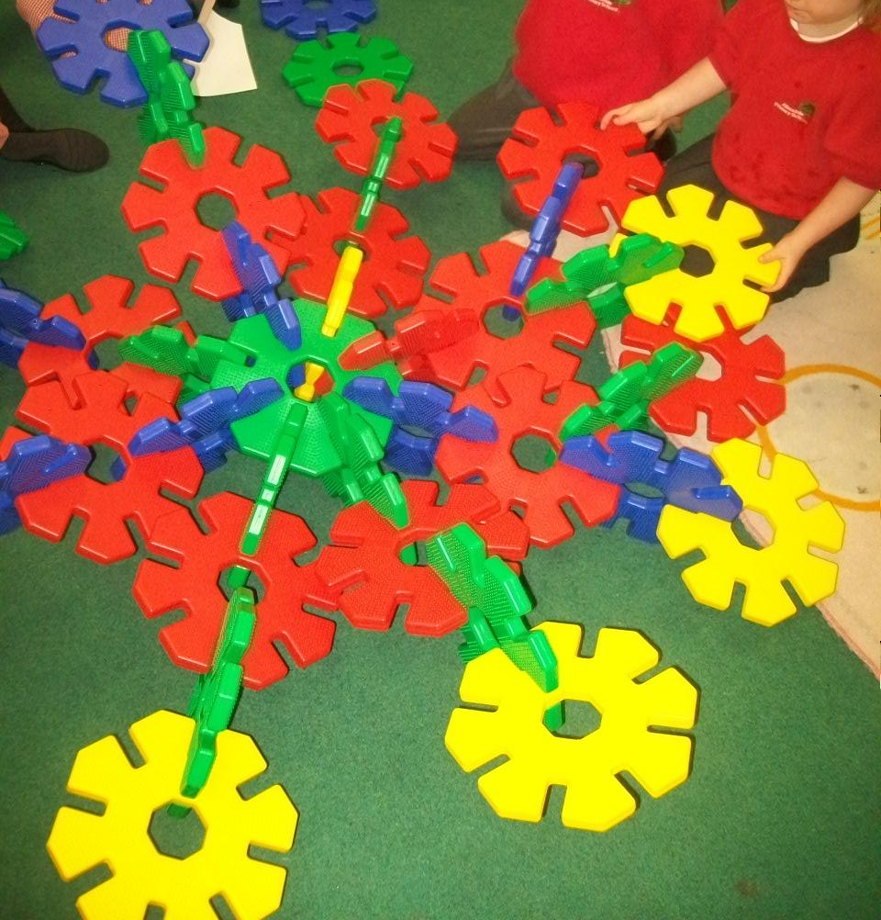
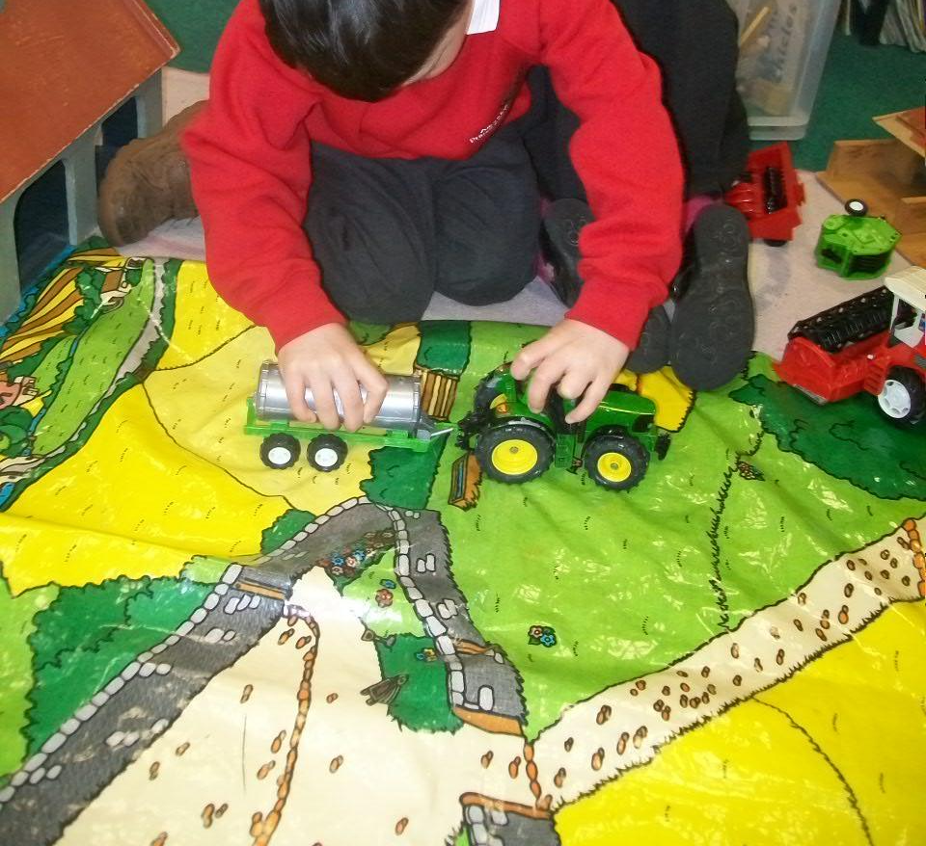
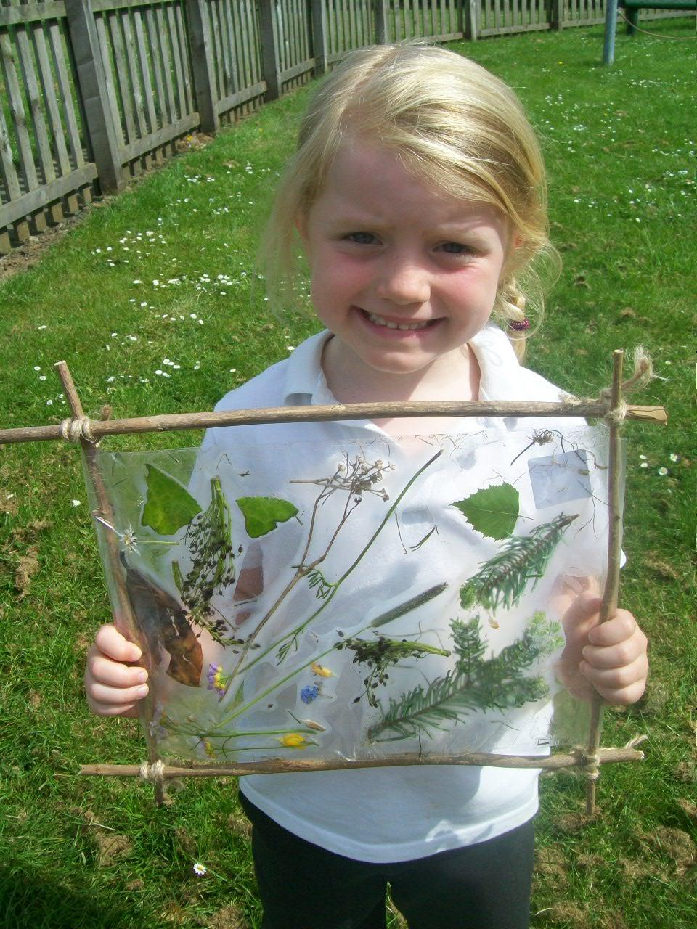
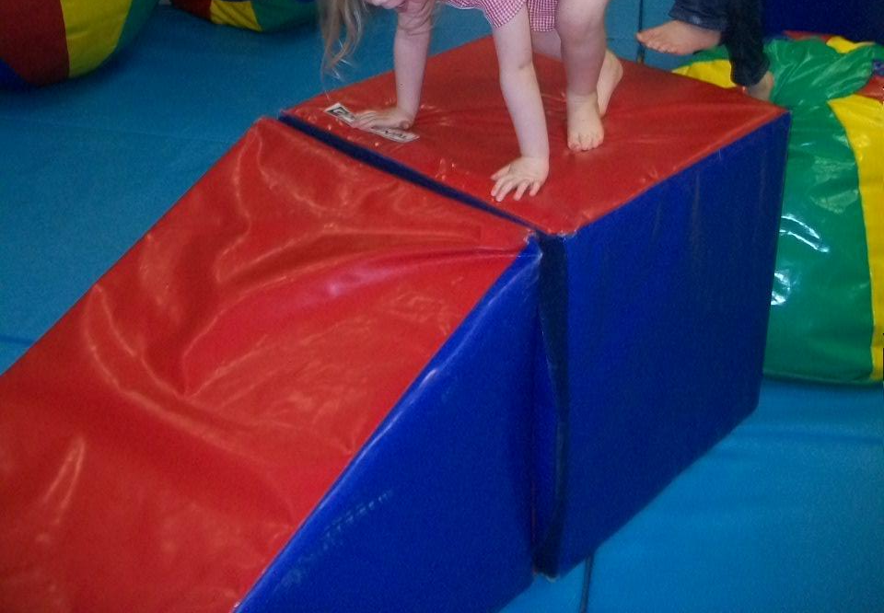
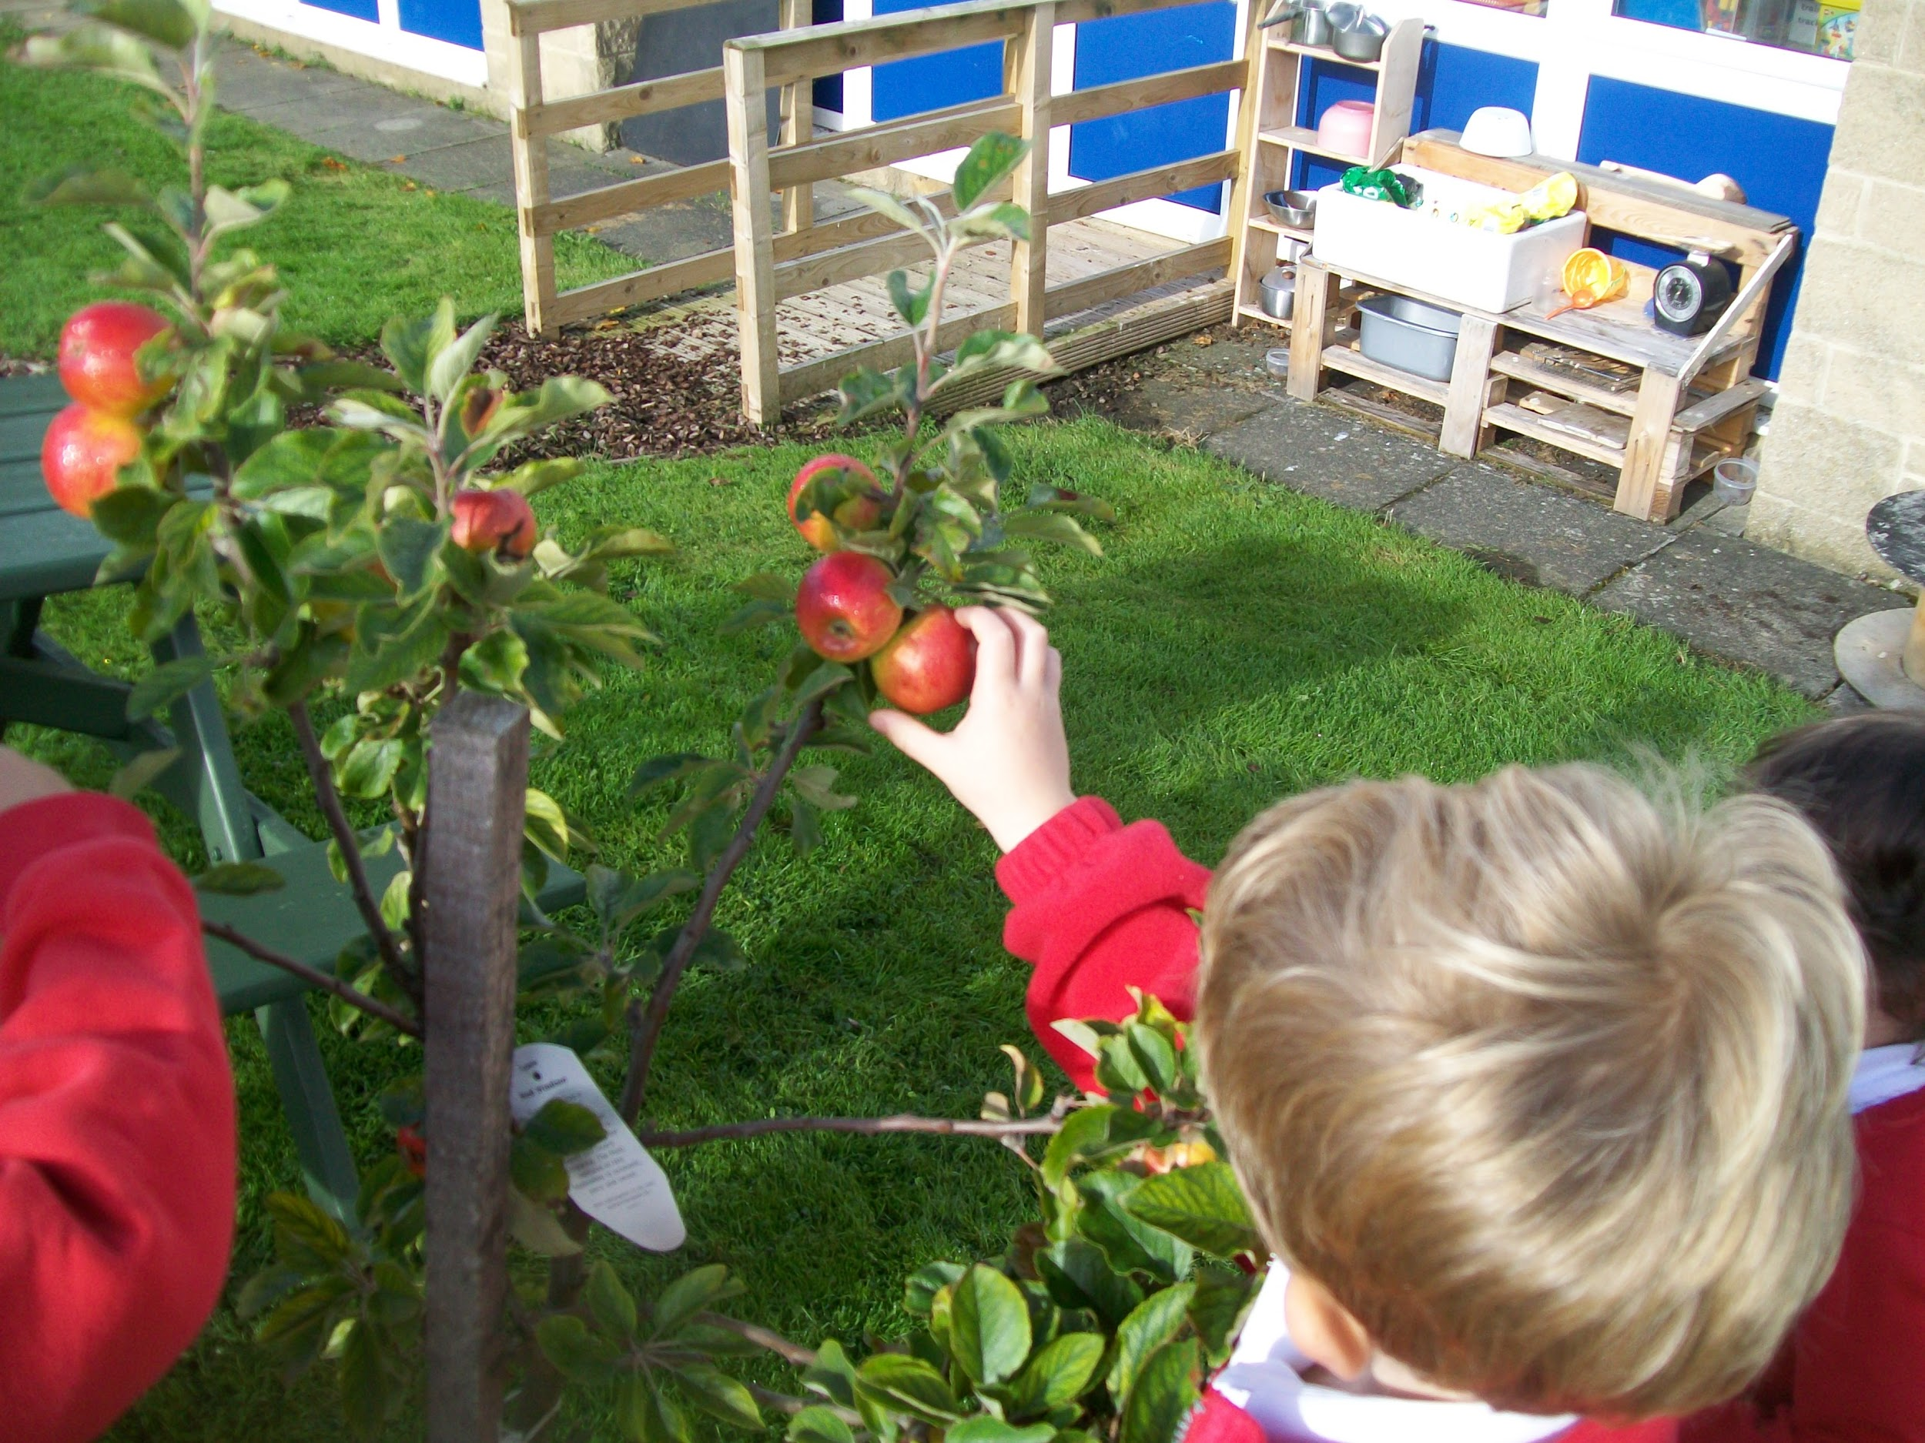
Lots of things will be here to play with. But some things may have moved and some things may have been put away for a little while. These are some of the things that will be there for you to play with.

Slide 11
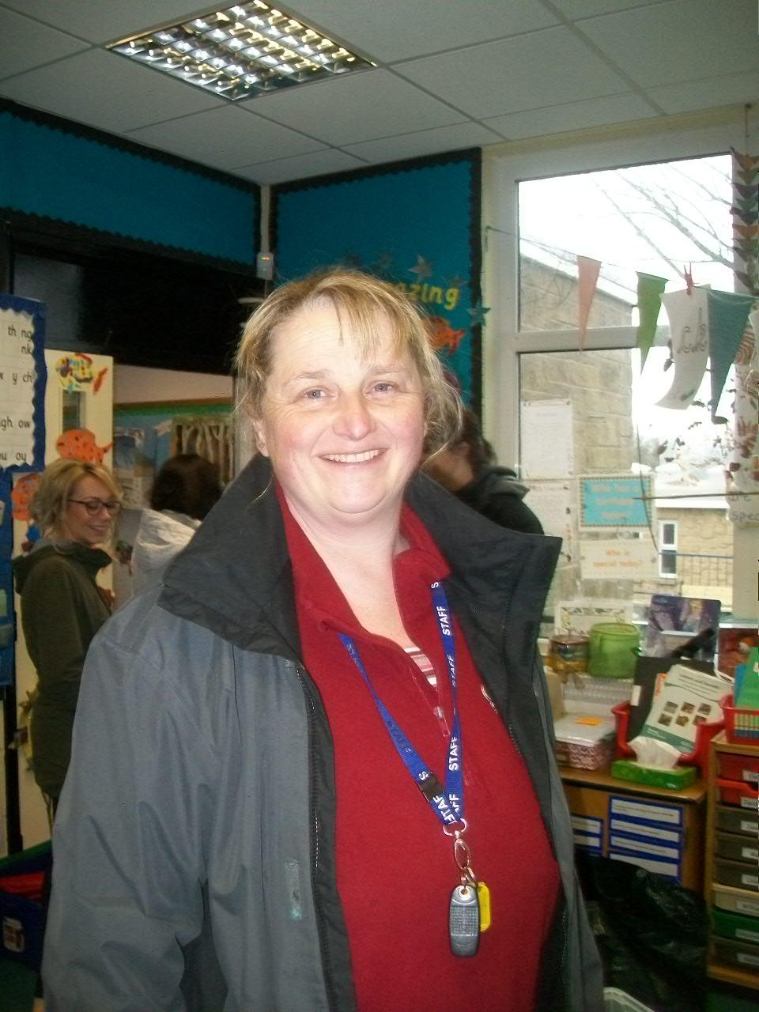
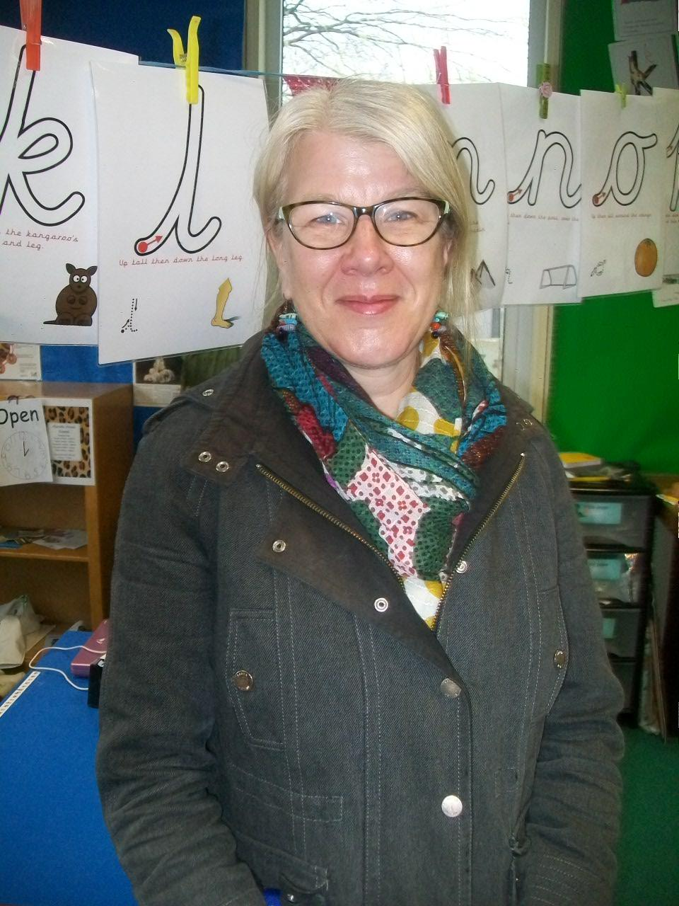
We’ve set up the areas in the Pipit class so not too many children play in them at the same time. There are signs to tell you how many children can play in an area at one time. It may have a 1, 2, 3, or 4. But don’t worry as Karen and Miss Armstrong are always there to help you to learn, play, have fun and stay safe.

Slide 12
It’s important that we keep our hands really clean to keep everyone safe and stop anyone catching the Coronavirus. This is the Pipits porch where the boys and girls toilets are and where you can wash your hands at School.

Slide 13
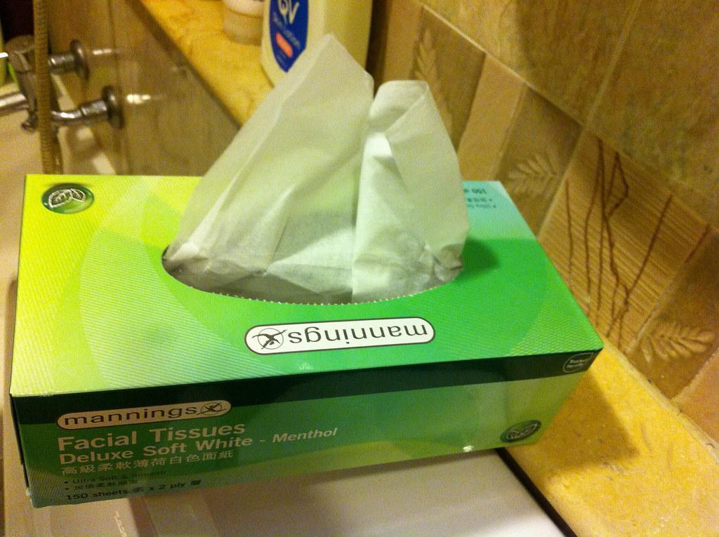
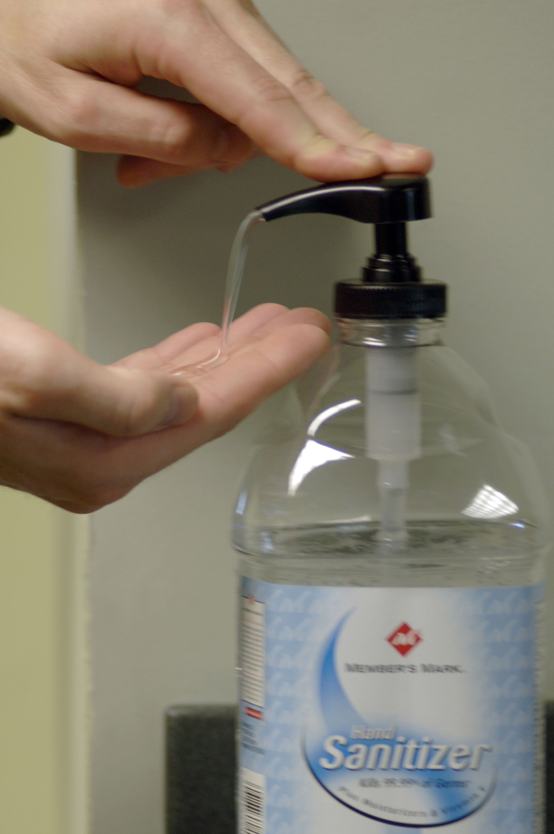
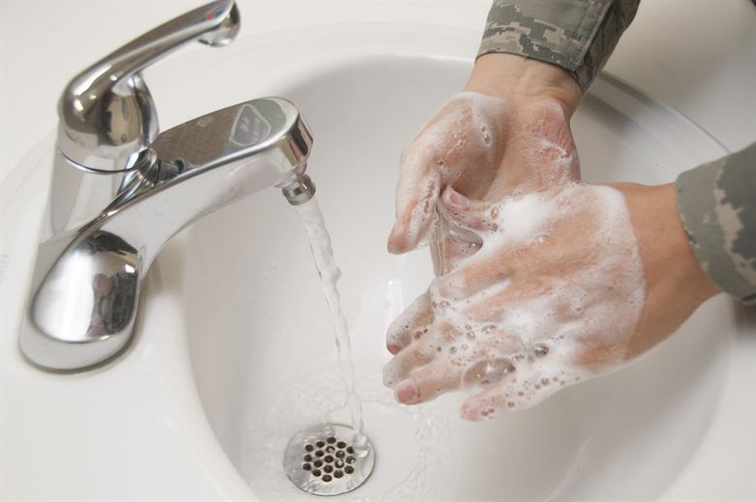
We’ve got lots of tissues for you to use for blowing your nose. We’ve put them right next to the bin so you can pop it straight in afterwards. Don’t forget to wash your hands again!

Slide 14
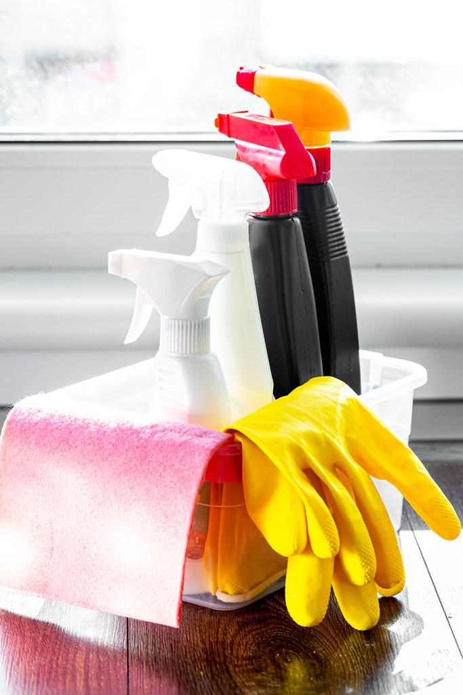
We all need to help keep our school very clean so we can have lots of fun together cleaning some of the toys after we’ve played with them. We might wash the bikes at the ‘car wash’ or ‘bath’ the toys in a bucket of soapy water.

Slide 15
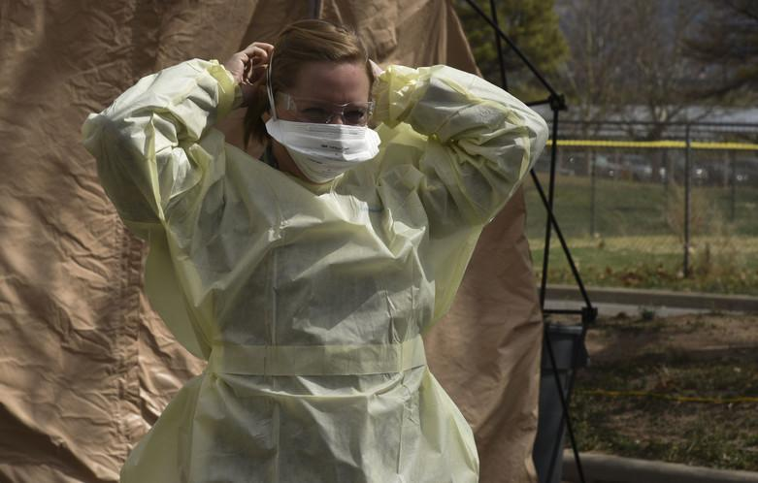
Sometimes, your teachers might need to wear some special things to keep us all safe. Like when you are poorly or need to have your clothes changed.

Slide 16
When it’s time for you to go home, this is where we will go to meet your grown-up. They will wait at the bottom of the ramp and we will send you out to them once we can see them.

